Slide 1
Data for Health Surveillance ISDS Pre-Conference December 6, 2016 Amy Ising ising@ad.unc.edu

Slide 2
Discussion Overview
Introduction to Syndromic Surveillance
Data Elements: Focus on Chief complaints / triage notes and ICD-9/10-CM codes
Sample use cases
Presenting data to stakeholders

Slide 3
Surveillance Definition
Public health surveillance is the systematic, ongoing collection, management, analysis, and interpretation of data followed by the dissemination of these data to public health programs to stimulate public health action
https://www.cdc.gov/mmwr/preview/mmwrhtml/su6103a2.htm
Notes:
Have a clear purpose or purposes for your system
Design it to meet that purpose or purposes
Collect only data you will use
Use automated data collection wherever feasible
Show providers of data and the public you are using the data well
Build on personal relationships, not rules
Assess your data feed in real time for quality as well as anomalies
Evaluate your system periodically against its purposes

Slide 4
Source: FL Department of Health, Bureau of Epidemiology

Slide 5
Syndromic Surveillance: All Hazards
Early Event Detection
Situational Awareness
Rumor control
Broader public health surveillance including:
Injuries
Infectious disease trends
Post-disaster surveillance
Occupational health, chemical exposures, etc.
Chronic diseases (asthma, diabetes)
Notes:
Provide ongoing, timely intelligence and data on public health threats and health conditions of interest
Support early identification or ruling out of PH threats
Assist in characterizing population groups at greatest risk
Assist in assessing the severity and magnitude of possible threats and the effectiveness of control measures
Assist with continual evaluation and development of new andimproved surveillance practices
Keep stakeholders, public health leadersghipo and the public informed
Support collaborative efforts with health providers, media, first responders and government decision makers
Allow public health agencies to take action in response to each reported case
Allow rapid detection of and response to outbreaks of disease
Support planning of public health and other prevention programs
Support evaluation of public health and other prevention programs
Provide timely data to clinicians to allow them to improve patient care

Slide 6
Data Transmission Process
Raw, Uncategorized, Unfiltered (Secondary) Data
From Data Provider
ETL / data processing / categorization into “syndromes”
Analysis
- Review reports
- Run ad hoc queries
Report Findings & Take Action (when needed)
Automated Processes
Data Provider does NOT filter or categorize data
prior to transmission to public health agency

Slide 7
Data Processing (NC Example)
Receipt
ED data received twice daily
SSIS used to process data
Binning
Records are binned into 0,1 or more syndromes
Some syndromes are assigned “dynamically”
Web
Users review syndromes & alerts on Java-based Web application
Algorithms
CUSUM Algorithm applied
Time of Arrival Algorithm Applied
Data Elements Used: chief complaint, triage notes, initial temp, ICD-9/10-CM codes (sometimes other elements, e.g. transport)

Slide 8
Emergency Dept Data Limitations
Secondary data (no control over data entry)
Free text data are invaluable but do not indicate confirmed cases
ICD-9/10-CM codes indicate diagnoses but can come in weeks later than chief complaints & triage notes

Slide 9
Free Text ED visit Data → Syndrome
Chief Complaint | Triage note | Syndrome
FEVER | Amb c/o yest fever 102, n/v.today just general aches no meds taken today. | GI-Severe
FEVER | 27 you male, c/o cough and congestion x1 wk. Denies ST, h/a, wheez. | Influenza-like Illness Respiratory
Throwing up | Rash on l leg,red swollen. Fever started today with back pain. | Fever/Rash GI-Severe

Slide 10
Syndrome Binning Case Definitions Queries

Slide 11
Syndrome “Binning”
Data elements to use
Terms to include
Terms to exclude
Negation

Slide 12
Fine-tuning queries
How do you search on “ear” without getting terms like “heart”?
SQL Options
LIKE '%[^a-z]ear[^a-z]%‘
Use a full text index with a CONTAINS statement, e.g.,
Where CONTAINS(*, ‘ear’)

Slide 13
Gastrointestinal Illness

Slide 14
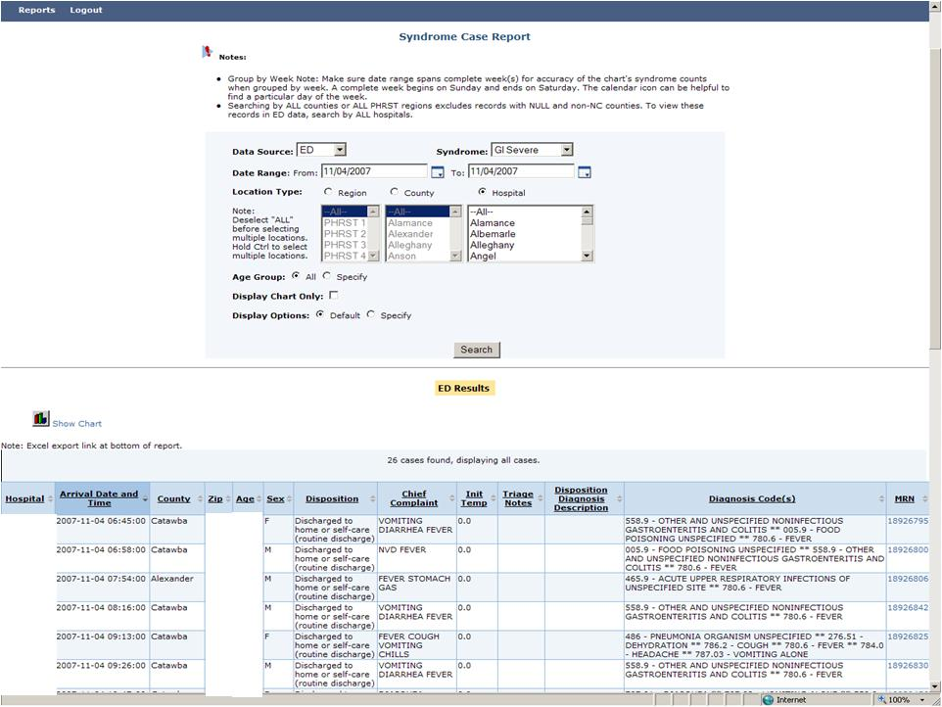
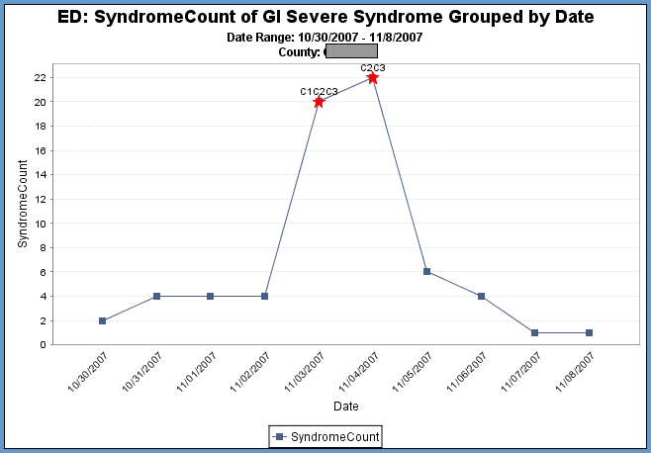
GI Outbreak Example
Notes:
14

Slide 15
Severe Weather

Slide 16
Hurricane Irene

Slide 17
Irene: Disaster Overview Report

Slide 18
Case Finding

Slide 19
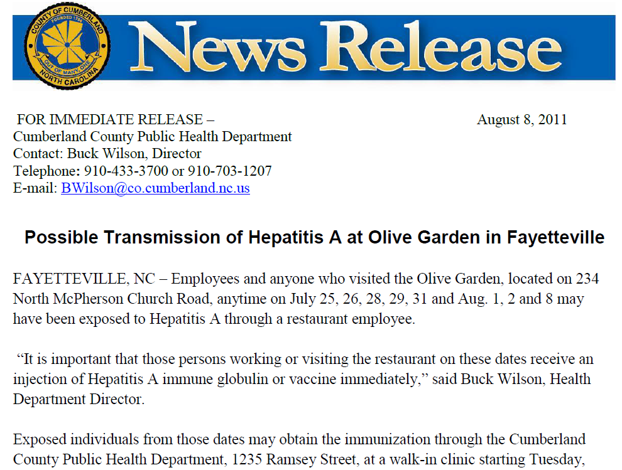

Slide 20
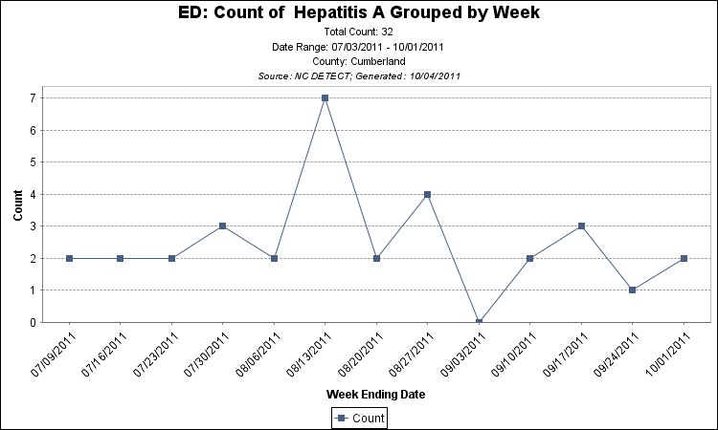
Olive Garden Hepatitis A
Keywords: jaundice OR hepa(titis).
Exclusions: Any mention of Hepatitis C OR heparin
Anything
Else?

Slide 21
Keyword Searches for Drugs

Slide 22
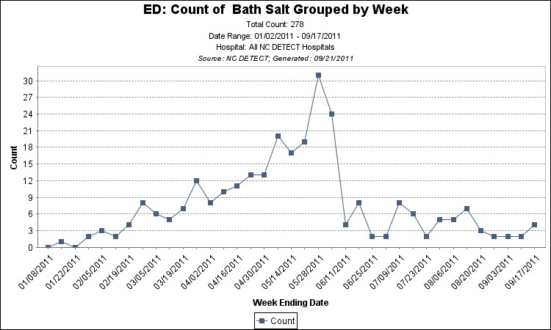
“Bath Salts”
6/1/2011: now illegal in NC

Slide 23
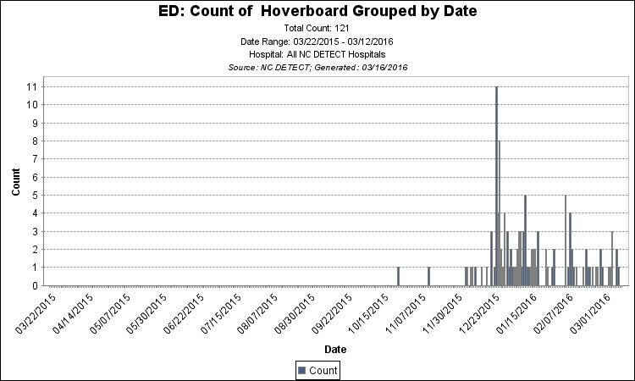
Hoverboard-related

Slide 24
Hoverboard-related Injuries
CC or Triage Note | Diagnosis Codes | External Cause Injury
Pt was on hoverboard when he fell off just PTA. Pt has approx 2 cm lac to left temperal area. | S01.01XA - LACERATION WITHOUT FOREIGN BODY OF SCALP, INITIAL ENCOUNTER | W22.03XA - WALKED INTO FURNITURE, INITIAL ENCOUNTER
pt states he fell off a hoverboard last pm now headache light and noise sensitive | S06.0X9A - CONCUSSION WITH LOSS OF CONSCIOUSNESS OF UNSPECIFIED DURATION, INITIAL ENCOUNTER | None Listed
Riding hover board at 7pm, left arm injury, no loc, no vomiting,GCS 15 | S52.552A - OTHER EXTRAARTICULAR FRACTURE OF LOWER END OF LEFT RADIUS, INITIAL ENCOUNTER FOR CLOSED FRACTURE | W17.89XA - OTHER FALL FROM ONE LEVEL TO ANOTHER, INITIAL ENCOUNTER
© 2016 University of North Carolina at Chapel Hill and NC Division of Public Health

Slide 25
Ebola / African Travel Hx Monitoring
Hospital | Arrival Date & Time | Age | Chief Complaint | Triage Notes
XX | XX | XX | Just returned from Africa today-stomach pain
XX | XX | XX | traveled from nigeria on 09/08/2014
 |  |  | Headache | Chief Complaint Subjective: Pt was on a plane from Johannesburg, South Africa today and developed a headache, fever, nausea and stiff neck. Pt with several episodes of vomiting, denies diarrhea.

Slide 26
Free text data processing for surveillance

Slide 27
Sample Free Text Data
Sample Chief Complaints | Sample Triage Notes
FLU SYMPTOMS | {FEVER DIARRHEA AND COUGH ASSOCIATED WITH BODY ACHES SYMPTOMS X 4 DAYS}
FEVER | VISITED AFRICA 5 WEEKS AGO. C/O FEVER AND VOMITING X 3 WEEKS. MOM WANTS PT CHECKED FOR MALARIA
SKIN DISORDER | pt has sore throat and swollen lymph glands in neck for last day. also tonight a small bump to left hand developed a necrotic center. pt has been working with sheep carcasses this past week adn is worried about anthrax.
DIAHERRA | pt ate peter pan peanut butter that had been recalled and thinks he may have salmonella poisoning - really nauseated, fever, diarrhea since eating sandwich last pm

Slide 28
Sample Free Text Data
Sample Chief Complaints | Sample Triage Notes
Evaluation: mental health | Patient Complaint: Family states he been hallucinating and seeing people this week. Sleeping very little. Has been snorting "bath salts" at times.
Other | possible food poisoning
ABD PAIN | pt to triage with abd pain, bloody stool. states friend was diagnosised with ecoli yesterday. (ate the same food)
HEAT STROKE? | {PT. BROUGHT BY COACH FROM FOOTBALL PRACTICE WITH C/O OVERHEATED; SHAKY; DIAPHORETIC. PT. HYPERVENTILATING UPON ARRIVAL; C/O CHILLS. IV INIATED UPON ARRIVAL.}

Slide 29
Sample Free Text Data
Sample Chief Complaints | Sample Triage Notes
FEVER NOS | NURSING TRIAGEHPI: Presents with chills, coughing, chest hurts, whole body aching and have a fever. +nausea. No vomiting. Sxs started yesterday (-)received previous treatment for this complaint PREHOSPITAL CARE: Theraflu - last night. OTHER: (-) resides at nursing facility, (-) foley placement prior to arrival, (-) homehealth, (-) hospice, (-) DNR. LMP: presentPMH: (-)cardiac, (-)high cholesterol (-)HTN, (-)diabetes, (-)hypothyroidism (-)cancer, (-)renal failure, (-)respiratory, (-)seizures, (-)strokes, (-)ulcers, (-) GERD (-)migraines, (-)kidney stones, (-)psychiatric hx, (-)HIV, (-)hepatitis, (-) MRSA (-)glaucomaSURGERIES: eye surgery. **Past medical and surgical history obtained from patient.PMD: no tobacco, no alcohol, no drugs.FH: (-)heart, (-)cancer, (-)HTN, (-)DM, (-)CVA., (-)renal.

Slide 30
Sample Free Text Data
Sample Chief Complaints | Sample Triage Notes
ABD PAIN | c/o abd pain since yesterday. Pain a recurent cramping sensation. +Nausea denies vomiting +diarrhea. Neg fever. Mask applied at triage. Pink, Warm, and Dry, No Acute Distress, Unlabored Respirations

Slide 31
Negation Challenge
Triage Notes are not always sentences with indexed findings and diseases
Successful negation processing in triage notes must account for:
Misspellings
Abbreviations
Acronyms

Slide 32
Solution: EMT-P + NegEx
EMT-P: Emergency Medical Text Processor
Developed at UNC (Debbie Travers, RN, PhD)
Cleans and standardizes chief complaint text using Java, Perl and UMLS
EXAMPLE: chst pn, CP, c/p, chest pai, chert pain, chest/abd pain, chest discomfort → chest pain
Triage note processing uses only select EMT-P modules
NegEx: https://code.google.com/p/negex/
Notes:
NegEx locates trigger terms indicating a clinical condition is negated or possible and determines which text falls within the scope of the trigger terms.

Slide 33
EMT-P Processing
Misspellings module: corrects common misspellings of medical concepts
Asmatha → asthma
Synonyms module: expands acronyms, abbreviations and truncations
Fuo → fever of unknown origin

Slide 34
NC DETECT Modifications
NegEx
Added negation terms found in triage notes
Added “STOP” words: (+), co, complaining of, multiple complaints, complains of, he, reports, she, and states to stop identification of negated term
Added “pre-cleaning” stage to work with NC DETECT records-based data
EMT-P
Tweaked to use only misspellings and synonyms module with additional terms added

Slide 35
Example Process: Step 1
Raw Triage Note
c/o upper cp x 2 days describes as "tightness". Pt states onset with movement and increases with respiration. Pt denies shob, n/v, diaphoresis, coughing, fev, radiation of pain, or injury.”

Slide 36
Step 2: Triage Note After EMT-P
Triage Note After EMT-P Modules
c/o upper chest pain x 2 days describes as "tightness". Pt states onset with movement and increases with respiration. Pt denies shortness of breath, nausea vomiting, diaphoresis, coughing, fever, radiation of pain, or injury.”

Slide 37
Step 3: Triage Note After NegEx
Triage Note After NegEx: Negation Terms Identified and Deleted
c/o upper chest pain x 2 days describes as "tightness". Pt states onset with movement and increases with respiration. Pt denies shortness of breath, nausea vomiting, diaphoresis, coughing, fever, radiation of pain, or injury.”

Slide 38
Final Product: Processed Triage Note
Processed Triage Note Ready for Syndromic Classification
c/o upper chest pain x 2 days describes as tightness. Pt states onset with movement and increases with respiration. Pt, radiation of pain, or injury.

Slide 39
ICD
WHO’s International Classification of Diseases
CM = “Clinical Modifications” for country-specific needs
ICD-9-CM in place since 1979
ICD-10 (mortality data) adopted 1999
In the US, move to ICD-10-CM was delayed multiple times but took effect on 10/1/2015
Notes:
The first standard we are going to talk about is ICD. ICD is the international classification of diseases developed by a committee within the World Health Organization. ICD lists codes for diagnoses and signs and symptoms.
Interestingly, countries will take the core ICD codes and add “clinical modifications” to them so each country might have slightly different ICD-CM codes. The same numeric code, then, might mean something different from country to country. This can make comparisons across countries a little difficult.
The US FINALLY moved to ICD-10-CM on October 1, 2015. It was a long time coming and didn’t have 100% support from many lobbying groups.

Slide 40
AMA President Robert Wah (11/14)
If it was a droid ICD-10 would serve Darth Vader … For more than a decade, the AMA kept ICD-10 at bay – and we want to freeze it in carbonite!”
http://www.ama-assn.org/ama/pub/news/speeches/2014-11-08-wah-interim-address.page

Slide 41
ICD-10-CM vs. ICD-9-CM Structure
ICD-9-CM Codes (n=14,025)
ICD-10-CM Codes (n = 68,069)
3-5 characters
1st character is numeric or alpha (E or V)
Characters 2-5 are numeric
3-7 characters
1st character is alpha
2nd character is numeric
Characters 3-7 are alpha or numeric
Use of decimal after 3rd character
Use of dummy placeholder “X”
Notes:
You can see why there might have been some hesitation on the part of providers to move to ICD-10-CM. You can see that the number of codes increased drastically. This means that physicians need to document in much greater detail than they had to previously so that coders have adequate documentation from which to assign codes appropriately.

Slide 42
Mapping Tools
http://www.syndromic.org/programs/icd-10-conversion/icd-10-mmrt
https://www.nahdo.org/node/250
https://www.cms.gov/medicare/coding/icd10/2015-icd-10-cm-and-gems.html
http://www.qualityindicators.ahrq.gov/resources/Toolkits.aspx
Download all codes: CDC ICD-10-CM page
Notes:
Here are links to some tools to help public health figure out which ICD-9-CM codes map to which ICD-10-CM codes. As you can imagine with a great increase in codes, the mapping can be quite difficult. There are new codes in ICD-10-CM that may not map to anything in ICD-9-CM. Also, there are some codes in ICD-9-CM that don’t map to one specific code in ICD-10-CM.

Slide 43
Heroin Overdose
Keywords?
ICD-9-CM Codes?
ICD-10-CM Codes?

Slide 44
ICD9CM Code | ICD9CM Description | ICD10CM Code | ICD10CM Description (enc. = encounter)
965.01 | Poisoning by heroin | T40.1X1A | Poisoning by heroin, accidental (unintentional), initial enc.
965.01 | Poisoning by heroin | T40.1X1D | Poisoning by heroin, accidental (unintentional), subsequent enc.
965.01 | Poisoning by heroin | T40.1X2A | Poisoning by heroin, intentional self-harm, initial enc.
965.01 | Poisoning by heroin | T40.1X2D | Poisoning by heroin, intentional self-harm, subsequent enc.
965.01 | Poisoning by heroin | T40.1X3A | Poisoning by heroin, assault, initial enc.
965.01 | Poisoning by heroin | T40.1X3D | Poisoning by heroin, assault, subsequent enc.
965.01 | Poisoning by heroin | T40.1X4A | Poisoning by heroin, undetermined, initial enc.
965.01 | Poisoning by heroin | T40.1X4D | Poisoning by heroin, undetermined, subsequent enc.
Source: Katie Harmon
Notes:
This is a table that my colleague Katie Harmon put together. The first two columns list the ICD-9-CM code and description for “poisoning by heroin.” The next two columns list the corresponding values from ICD-10-CM. You can see that ICD-10-CM provides more detail. ICD-10-CM also combines more information into one code than was the case for ICD-9-CM.
Enc. = encounter.
ICD-9-CM injury-related codes ask the coder to document whether or not this healthcare visit is for an initial encounter (code ends in “A”), subsequent encounter (code ends in “D”) or sequela (code ends in “S” – not shown).
As we talked about a couple of weeks ago, NC is doing a lot on opioid overdose surveillance, including using NC DETECT. Although ICD-10-CM includes more detail on encounter type as you can see above, it doesn’t provide any greater granularity on the types of opioids involved.

Slide 45
Rabies / Animal Exposures
Keywords?
ICD-9-CM Codes?
ICD-10-CM Codes?

Slide 46
Mammal Contact (ICD-9/10-CM)
CC or Triage Note | Diagnosis Codes | External Cause Injury
SWOLLEN HAND | Z23 - ENCOUNTER FOR IMMUNIZATION *-* M79.89 - OTHER SPECIFIED SOFT TISSUE DISORDERS | W53.21XA - BITTEN BY SQUIRREL, INITIAL ENCOUNTER
KICKED BY HORSE | S30.0XXA - CONTUSION OF LOWER BACK AND PELVIS, INITIAL ENCOUNTER | W55.12XA - STRUCK BY HORSE, INITIAL ENCOUNTER
Dog Bite | V04.5 - NEED FOR PROPHYLACTIC VACCINATION AND INOCULATION AGAINST RABIES *-* Z23 - ENCOUNTER FOR IMMUNIZATION *-* S51.851A - OPEN BITE OF RIGHT FOREARM, INITIAL ENCOUNTER | E906.0 - DOG BITE *-* W54.0XXA - BITTEN BY DOG, INITIAL ENCOUNTER

Slide 47
Reduced specificity with Immuniz.
Version | CC or Triage Note | Diagnosis Codes
ICD-10-CM | Pt was exposed and possibly bitten by a bat. Had partial rabies vaccination series out of town here today for next shot in series | Z23 - ENCOUNTER FOR IMMUNIZATION
ICD-9-CM | RABIES VAC | V04.5 - NEED FOR PROPHYLACTIC VACCINATION AND INOCULATION AGAINST RABIES
© 2016 University of North Carolina at Chapel Hill and NC Division of Public Health

Slide 48
Sample Reports Data for Stakeholders & Public

Slide 49
Fact Sheets

Slide 50
Weekly Reports
CO
Heat
Flu

Slide 52
